Slide 1

It’s getting hot in here: A novel application of heatmaps to health outcomes research
January 8, 2020
Jessica Lavery, MS, Research Biostatistician
Work done in collaboration with Kathy Panageas, DrPH and Peter Bach, MD

Slide 2
Abstract
Heatmaps are a commonly employed data visualization tool used to identify clusters in gene expression data. We present a novel application of heatmaps and cluster analyses to health outcomes research in the setting of assessing hospital performance of cancer-directed surgery. Multiple types of cancer-directed surgeries at over 3,000 hospitals over a three-year period were examined. Hospital-level outcome measures of 30-day mortality (from date of surgery) and 30-day unplanned readmissions (from date of discharge) were analyzed using random effects models and described using risk-standardized mortality rates. Traditionally, features associated with better or worse outcomes are assessed within the framework of regression and tests of association. In this application, we used heatmaps to identify clusters of high and low performing hospitals annotated along the characteristics of surgical volume, ownership (government, non-profit, private), teaching status, location (urban, rural). This data visualization and cluster analysis offers an alternative way to explore trends in hospital profiling data.

Slide 3
Outline
Motivating example
Overview of exploratory data reduction tools
Workflow & tools for generating heatmaps
Interpretation and benefits of applying heatmaps in this setting

Slide 4
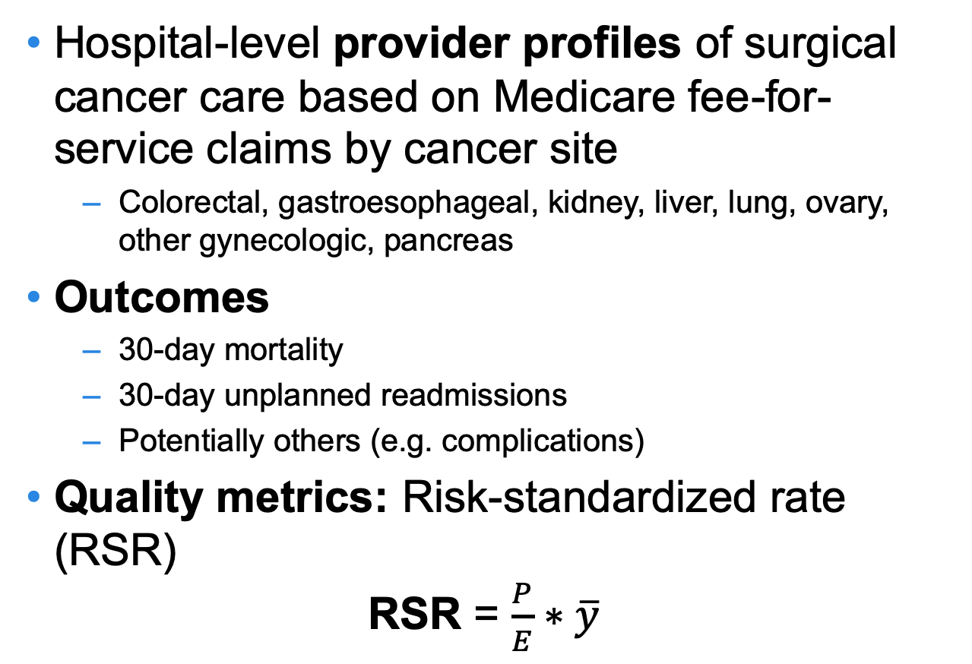
Motivating Example
Hospital-level provider profiles of surgical cancer care based on Medicare fee-for-service claims by cancer site
Colorectal, gastroesophageal, kidney, liver, lung, ovary, other gynecologic, pancreas
Outcomes
30-day mortality
30-day unplanned readmissions
Potentially others (e.g. complications)
Quality metrics: Risk-standardized rate (RSR) RSR = $\frac{P}{E}∗\overline{y}$
Notes:
Provider profiles: Intended to measure and report the quality of care at the provider level
RSR is standard measure for the field
RSR > y-bar = worse than average, < y-bar = better than average

Slide 5
Motivating Questions
Is there consistency in performance across cancer types and outcomes?
How is hospital performance on mortality related to hospital performance on readmissions?
How is hospital performance for lung cancer related to hospital performance for liver cancer?
Which hospitals or groups of hospitals should be targeted for quality improvement initiatives? Do they share similar characteristics?
Notes:
Profiles often involve multiple outcomes, and how hospitals perform on all of the outcomes simultaneously is often of interest
Frequently reported outcome measures are potentially correlated (e.g. mortality, readmissions, complications)

Slide 6
Exploratory Data Reduction Tools
Heatmaps
Hierarchical clustering
Clustering
Notes:
In order to think about how to answer those questions, we started to consider exploratory data reduction tools: How can we take a summary measure (RSR) for hundreds of hospitals across multiple cancer sites and outcomes and easily glean patterns in the data?

Slide 7
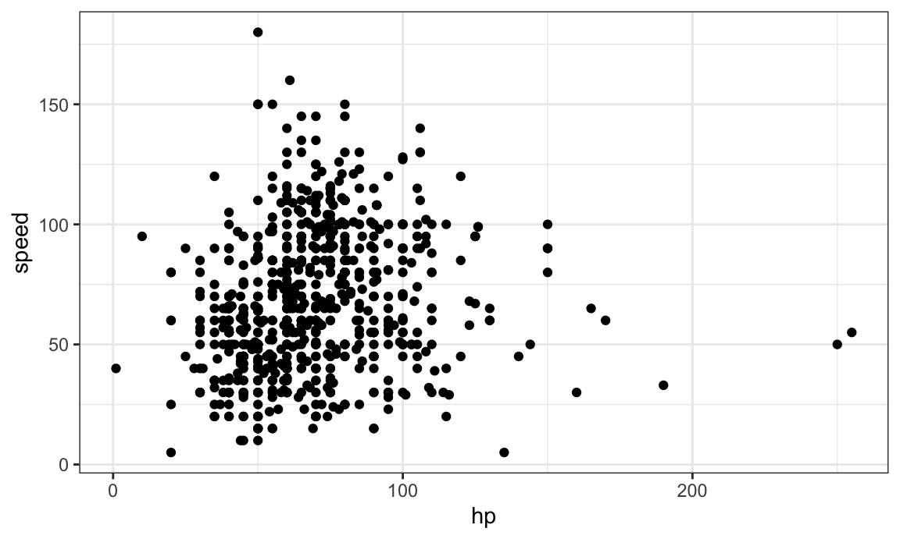
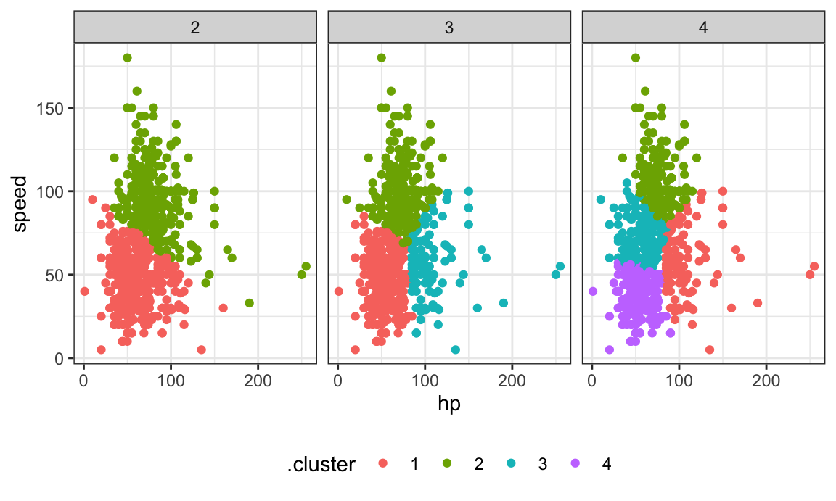
Exploratory Data Reduction Tools
Cluster analysis: Identify homogenous groups and distinguish from other groups
Notes:
On the left you’re starting with one indistinguished group of data, to the right, depending on how many clusters you’re looking for, the data can be parsed into separate groups
Figures taken from https://p8105.com/stat_learning.html#example

Slide 8
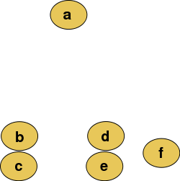
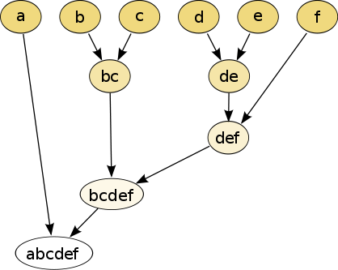
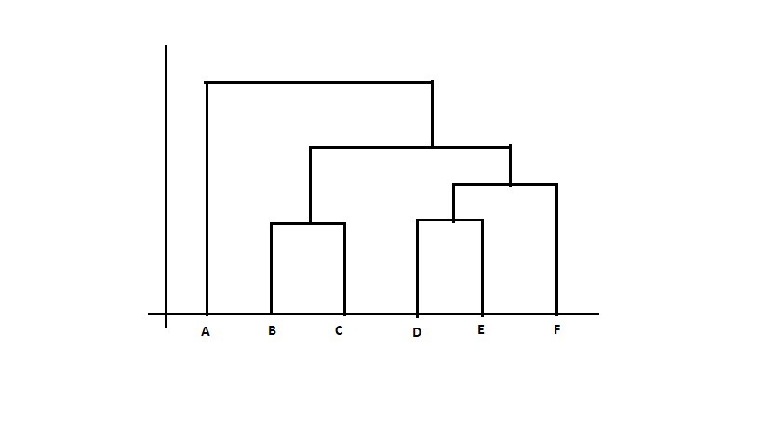
Exploratory Data Reduction Tools
Hierarchical clustering: Nest clusters based on similarities/differences
Primary visualization tool is a dendrogram
Notes:
Starting from the bottom of the righthand figure…

Slide 9
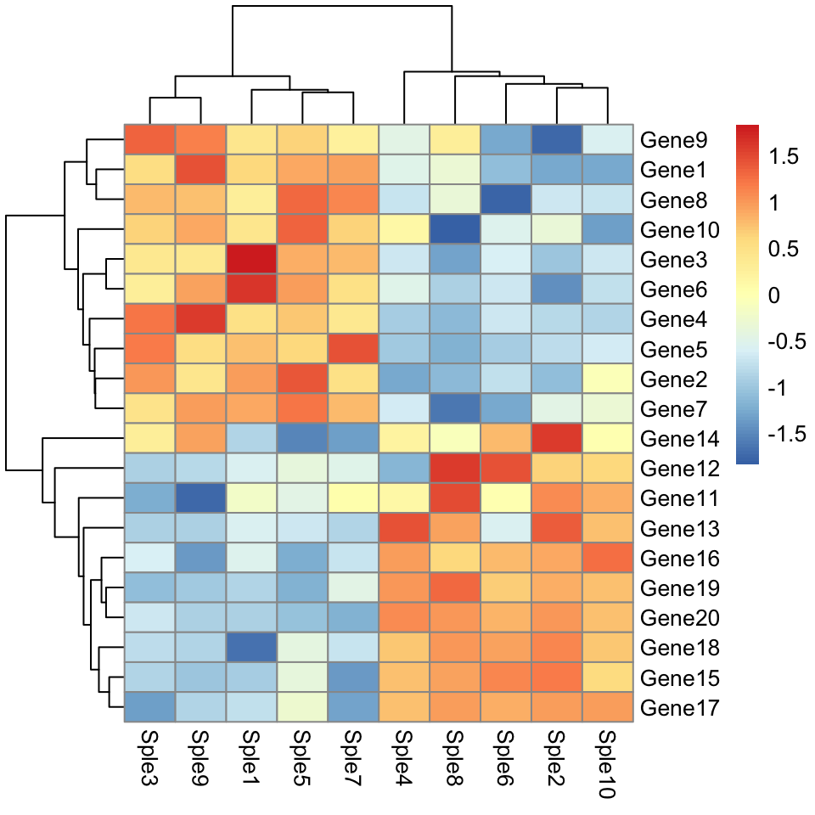
Exploratory Data Reduction Tools
Heatmaps: Color-coded visual representation of a matrix of values
Annotated to visualize hierarchical clustering
Interpretation:
Each column represents a patient sample
Each row represents a gene
The colors correspond to the level of gene expression
Notes:
* Red = highly expressed, blue = opposite
* mention dendrogram of hierarchical clustering on side and top
* the ordering of the patients and the genes is based on how they cluster

Slide 10
Heatmaps
Typical application: Most frequently used in genomics to visualize expression data for hundreds of genes
Identify genes that are commonly regulated
Identify gene expressions associated with a particular disease
Proposed application: Visualize clusters of hospitals along different outcomes and cancer sites
Each column represents a hospital
Each row represents an outcome for each cancer site
The colors corresponds to the value of the RSR for each hospital’s outcome

Slide 11
Workflow
Prepare data for cluster analysis
Generate & interpret heatmap
Prepare data for visualization

Slide 12
Preparing for cluster analyses
Starting with risk standardized rates (RSR) for each hospital, cancer site and outcome
Typical distance measures used to create hierarchical clusters assume that the data are normally distributed
Start by visually inspecting the distribution of the data
If not normally distributed, consider log or other transformation
Hospital | Cancer site | Outcome | RSR
A | Lung | Mortality | x.xx
A | Lung | Readmissions | x.xx
A | Gastroesophageal | Mortality | x.xx
A | Gastroesophageal | Readmissions | x.xx
A | Etc.
Notes:
This is a standard first step when applying heatmaps to genomic research, applied here for consistency
If using a different distance measure may not need to perform this step; data/situation-dependent

Slide 13
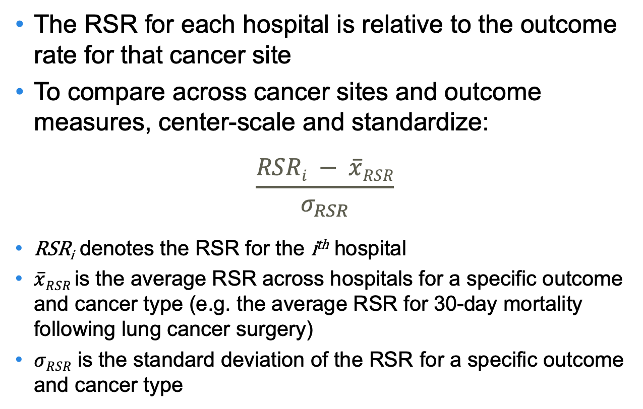
Preparing for data visualization
The RSR for each hospital is relative to the outcome rate for that cancer site
To compare across cancer sites and outcome measures, center-scale and standardize:
$$\frac{RSRi − \overline{x}RSR}{σ_{RSR}}$$
RSR_{i} denotes the RSR for the i^{th} hospital
$\overline{x}RSR$ is the average RSR across hospitals for a specific outcome and cancer type (e.g. the average RSR for 30-day mortality following lung cancer surgery)
$σRSR$ is the standard deviation of the RSR for a specific outcome and cancer type
Notes:
Scale because each RSR is relative to the mortality/readmission rate for that cancer site, want to compare across cancer sites and outcomes

Slide 14
Generate the heatmap
Implement via standard software tools
pheatmap package in R
Other tools: heatmap and heatmap.2 functions in base R, heatmaply package
Specify hierarchical clustering algorithm (linkage method)
There is no one right answer
Complete (farthest neighbor; default in pheatmap): Distance between two groups defined as the maximum possible distance between points in two different clusters
Others: Single (nearest neighbor), average, median, centroid, Ward, McQuitty
Differ in how the proximity between any two clusters is defined at each step
Notes:
Heatmaply2 allows for interactive heatmaps
Explanations of distance measures: https://stats.stackexchange.com/questions/195446/choosing-the-right-linkage-method-for-hierarchical-clustering/217742#217742
Pros and cons of distance measures: https://towardsdatascience.com/understanding-the-concept-of-hierarchical-clustering-technique-c6e8243758ec

Slide 15
Clustering Algorithms
Complete linkage: Distance between two groups defined as the maximum possible distance between points in two different clusters
Single (nearest neighbor): Distance between two groups defined as the distance between their two closest members
Average (weighted pair-group): Distance between two groups defined as the average distance between each of the members, weighted so that two groups have equal influence on the final result
Median: Distance between two groups defined as the weighted distance between centroids, with weight proportional to the number in each group
Centroid (unweighted pair-group): Distance between two groups defined as the distance between their centroids
Others: Ward, McQuitty
Notes:
Useful reference: https://towardsdatascience.com/understanding-the-concept-of-hierarchical-clustering-technique-c6e8243758ec
Complete linkage clustering: Find the maximum possible distance between points belonging to two different clusters.
Single linkage clustering: Find the minimum possible distance between points belonging to two different clusters.
Mean linkage clustering: Find all possible pairwise distances for points belonging to two different clusters and then calculate the average.
Centroid linkage clustering: Find the centroid of each cluster and calculate the distance between centroids of two clusters.
https://datascienceplus.com/hierarchical-clustering-in-r/
https://ncss-wpengine.netdna-ssl.com/wp-content/themes/ncss/pdf/Procedures/NCSS/Clustered_Heat_Maps-Double_Dendrograms.pdf

Slide 16
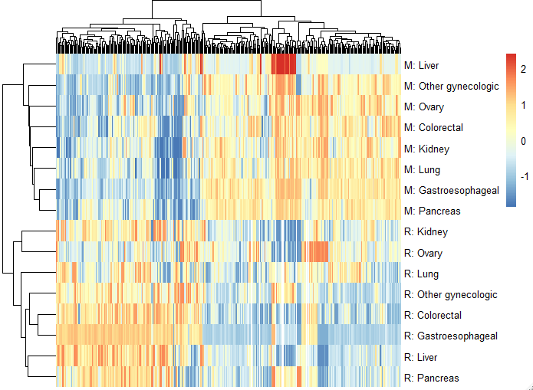
Results
Each column = 1 hospital
Notes:
* Each column indicates a hospital, dendrogram on the top indicates clusters of hospitals
* Each row indicates an outcome for a given cancer site, M indicates mortality outc, R indicates readmission outc
* The color scale indicates how high (poor performance) or low (high performance) an RSR is compared to other hospitals
* Dendrogram to the top indicates clusters of hospitals
* Dendrogram to the left indicates clusters of outcomes
Assembles the hospitals based on the clustering algorithm
Indicating that hospitals that have low mortality rates (blue, upper left quadrant) often had higher than average readmission rates (lower left quadrant) and the opposite: hospitals that had high mortality rates (top right quadrant) often had below average readmission rates (lower right quadrant)
In this case this relationship has been previously demonstrated and points to why readmissions may not be the best performance quality measure, but as other outcomes are explored this will be increasingly useful to examine.

Slide 17
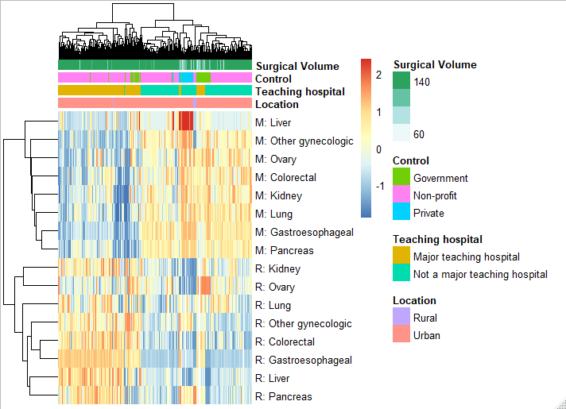
Notes:
Introduce annotation of hospital characteristics at the top

Slide 18
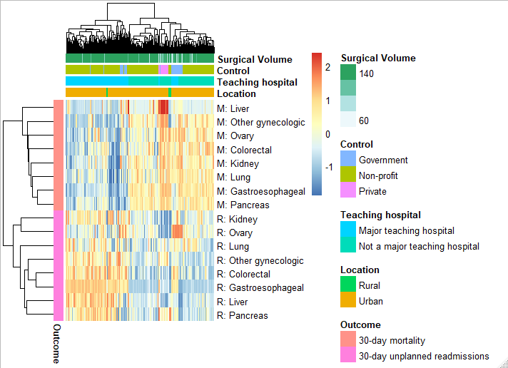
Notes:
Introduce clustering on outcomes to the left

Slide 19
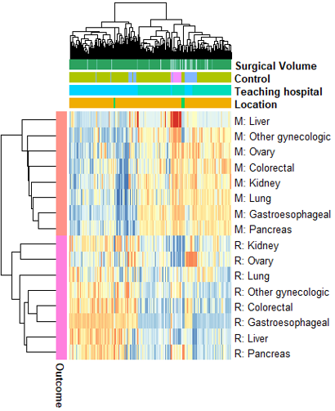
Interpretation of Results
Hospitals that have low mortality rates frequently had high readmission rates, and vice versa
Hospitals clustered based on hospital-level characteristics, most notably teaching status
Surgical outcome measures were generally similar across cancer types
Need to consider missing data and generalizability
Notes:
Could study characteristics associated with higher performing hospitals and leverage this information for quality improvement initiatives

Slide 20
Missing data considerations
Started with 3,540 hospitals that performed at least 1 cancer surgery among cancer sites considered
If requiring hospitals to have an outcome measure for each of the 8 cancer sites, would be left with only 365 (10%) hospitals
Number cancer sites required | Hospitals included | % of original hospitals
8 | 365 | 10%
7 | 579 | 16%
6 | 903 | 26%
5 | 1233 | 35%
4 | 1622 | 46%

Slide 21
Applying Heatmaps to Health Outcomes Research
Clearly visualized outcomes to hundreds of hospitals across 2 outcome measures for 8 cancer sites
Utility of data reduction and data visualization increases as more outcome measures or cancer sites are added; tables become increasingly cumbersome
Quickly identified patterns that may have otherwise gone undetected
Note: No formal statistical testing
Easily extends to other applications: Doesn’t have to be used with an RSR, can be used with any numeric hospital quality metric

Slide 22


Thank you!
Special thanks to Arshi Arora, Margie Hannum, Venkat Seshan and Ronglai Shen at MSK for their generosity in sharing their time and knowledge of heatmaps.
laveryj@mskcc.org
www.JessicaLavery.com

